Slide 1
Divy Bike Project
Manjula Bhamidi
12/29/21
Data provided by: https://divvy-tripdata.s3.amazonaws.com/index.html

Slide 2
Member-casual rides
Analyzed Data for Member riders and Casual riders on day of the week
Member riders are less than Casual riders

Slide 3
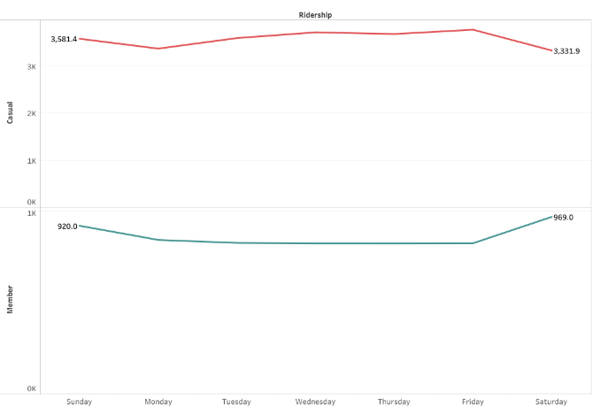
Casual-Member Rides data
Member riders are less on working days.
Casual riders are less in weekends.

Slide 4
Number riders per day
Casual riders are less than member riders from Monday to Friday. In the weekend Casual riders almost equal to member riders.

Slide 5
Thank you

